Slide 1



Name of Project:
Multi-Class Animal Recognition for wildlife conservation - AI

Slide 2

Learning Objectives:
Develop an AI-powered system: Create a robust and efficient system for multi-class animal recognition.
Improve conservation efforts: Support wildlife conservation by enabling accurate and efficient monitoring and tracking of animal populations.
Enhance research and analysis: Provide insights into animal behavior, population dynamics, and habitat health.
GOAL
Source :
www.freepik.com/

Slide 3
Methodology:
Data Collection:
Image and video datasets: Collect images and videos of various animal species from sources like camera traps, drones, and other relevant sources.
Data annotation: Annotate and label the collected data with species information, bounding boxes, and other relevant metadata.
2. Data Preprocessing:
Data cleaning: Remove duplicate, noisy, or irrelevant data.
Data augmentation: Apply techniques such as rotation, flipping, and scaling to increase dataset diversity.
Data normalization: Normalize image data to ensure consistency.
3. Model Development:
Convolutional Neural Networks (CNNs): Design and train CNNs for image classification and object detection tasks.
Transfer Learning: Utilize pre-trained models (e.g., ResNet, VGG) and fine-tune them for the specific task.
Model evaluation: Evaluate model performance using metrics such as accuracy, precision, recall, and F1-score.
4. Model Optimization:
Hyperparameter tuning: Optimize hyperparameters (e.g., learning rate, batch size) for improved model performance.
Model pruning: Prune the model to reduce computational requirements and improve inference speed.
5. Deployment:
Cloud deployment: Deploy the model on a cloud platform (e.g., AWS, Google Cloud) for scalability and accessibility.
API development: Develop a RESTful API for integrating the model with other applications and services.
6. Model Monitoring and Maintenance:
Model monitoring: Continuously monitor model performance and update the model as needed.
Data drift detection: Detect changes in data distribution and update the model accordingly.
7. Collaboration and Knowledge Sharing:
Collaboration with experts: Collaborate with wildlife experts and conservationists to ensure the model's effectiveness and relevance.
Knowledge sharing: Share knowledge, models, and results with the broader conservation community.

Slide 4
Tools and Technology used:
Python: Primary language for development, data analysis, and machine learning.
Jupyter Notebook: Interactive environment for data analysis, visualization, and prototyping.
Git: Version control system for managing code and collaborating with team members.

Slide 5
Problem Statement:
Wildlife conservation efforts are hindered by the lack of efficient and accurate methods for monitoring and tracking animal populations. Manual identification and classification of animals in images and videos captured by camera traps, drones, and other sources is time-consuming, labor-intensive, and prone to errors.

Slide 6
Solution:
Species Identification: Accurately identify and classify multiple animal species in images and videos.
Object Detection: Detect and locate animals in images and videos.
Real-Time Processing: Process images and videos in real-time, enabling efficient monitoring and tracking.

Slide 7
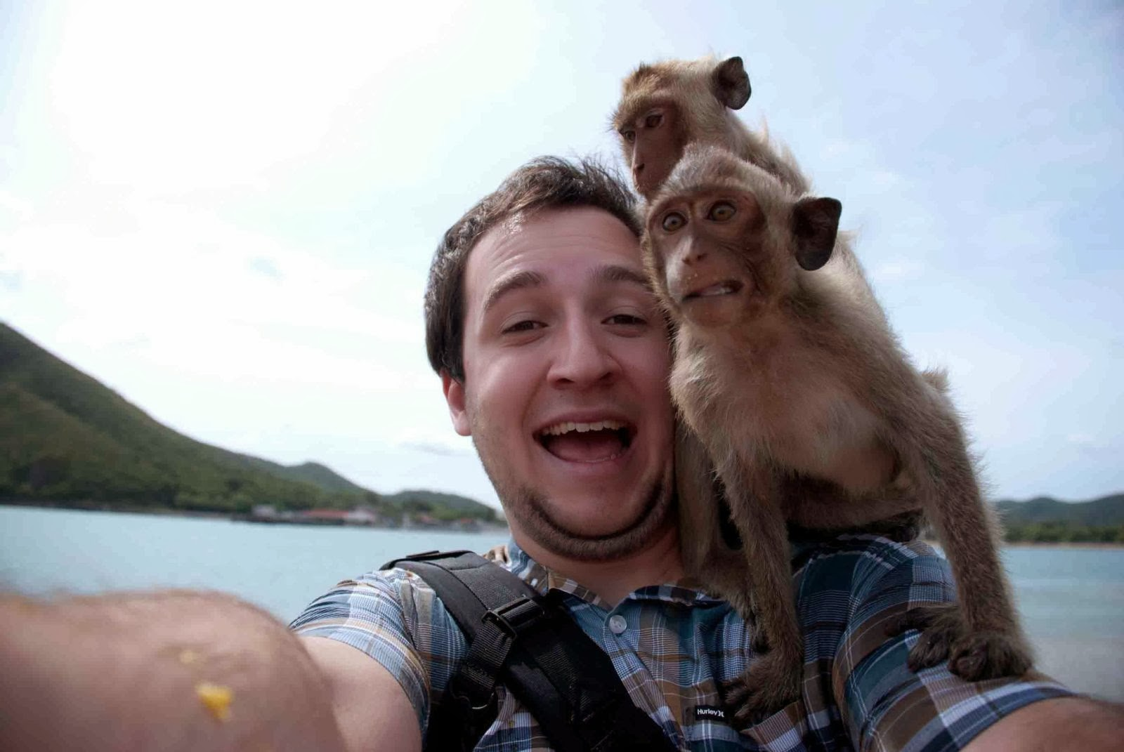
Screenshot of Output:

Slide 8
Conclusion:
Future Directions:
Expansion to new species: Expanding the solution to recognize and classify additional animal species.
Integration with existing systems: Integrating the solution with existing conservation systems and tools.
Collaboration and knowledge sharing: Collaborating with conservationists, researchers, and stakeholders to share knowledge and best practices.
Impact:
The project has the potential to make a significant impact on wildlife conservation efforts, enabling more efficient and effective conservation practices, and ultimately contributing to the protection and preservation of biodiversity.

